Slide 1

Thesis Topic: Optimizing Distributed Tracing and Telemetry in Microservices Using OpenTelemetry.
Name: Md Nur Mohammad
Masters in Communication systems and Networks at TH Köln
Student ID: 11145131
Supervisor:
EL Hussien Habib
Observability Site Reliability Engineer @Trivago

Slide 2
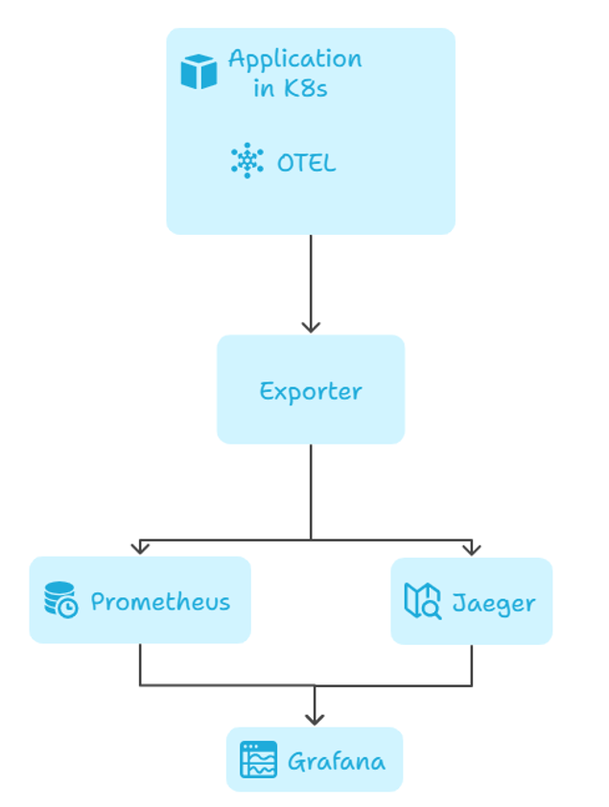
Workflow Diagramm

Slide 3
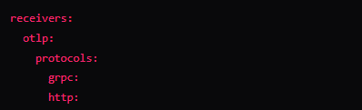
Receivers
This allows your microservices to send traces, metrics, and logs using OTLP protocol
Supports both gRPC and HTTP
Also configures CORS, so even browser apps can send data.

Slide 4

Receivers
It sends pings to your frontend (proxy) to check if it's alive.

Slide 5

Receivers
It listens to Docker directly.Supports both gRPC and HTTP
It grabs container-level stats: CPU, memory, IO, etc.

Slide 6
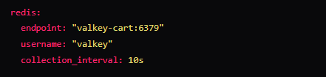
Receivers
Pulls Redis performance data every 10 seconds.

Slide 7
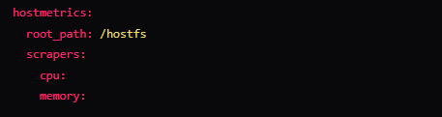
Receivers
Gets low-level system metrics (CPU, memory, disk, etc.) from the host machine.
Filters out unnecessary mount points and filesystem types to avoid noise.

Slide 8

Processors
Ensures the Collector doesn’t consume too much RAM.
Batch
Groups telemetry data before sending it out — efficient and safe.

Slide 9

Processors
Cleans up span names. Instead of showing 100 different product IDs in traces, it generalizes the path.

Slide 10
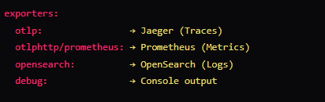
Exporters
Traces > Jaeger
Metrics > Prometheus
Logs > OpenSearch
Also printing everything with debug for testing

Slide 11

Connectors
Converts trace spans into Prometheus-compatible metrics.
Useful for visualizing latency and error rate trends in dashboards.

Slide 12

Service Pipelines- Traces
Collector will receive telemetry data using the OTLP protocol
OTLP supports both gRPC and HTTP input
Commonly used by SDKs in applications to send traces, metrics, or logs.

Slide 13

Service Pipelines- Metrics (Receivers)
hostmetrics – Collects OS-level metrics (CPU, memory, disk, etc.).
docker_stats – Gathers metrics from Docker containers running on the host.
httpcheck – Performs synthetic health checks to endpoints (checks availability and response time).
otlp – Receives telemetry data (traces, metrics, logs) from instrumented applications.
redis – Collects metrics from a Redis server.
spanmetrics – Converts spans (from trace data) into metrics (e.g., request duration, error rate).

Slide 14
Service Pipelines- Metrics (processors)
memory_limiter – Controls memory usage of the Collector; drops data if memory exceeds a threshold.
batch – Groups data into batches before exporting to optimize performance.

Slide 15
Service Pipelines- Metrics (Exporters)
otlphttp/prometheus – This is a custom-named OTLP HTTP exporter that exposes Prometheus-compatible metrics.

Slide 16

Service Pipelines- Logs
receivers: [otlp] Accepts telemetry data over the OpenTelemetry Protocol (OTLP)
processors: [memory_limiter, batch]
> memory_limiter
1. Protects the Collector from using excessive memory.
2. Drops incoming data when memory usage crosses safe limits.
3. Ensures Collector stability during high load or bursts.
> batch
1. Collects telemetry data into batches before exporting.
2. Improves throughput, performance, and network efficiency.
3. Reduces the number of calls made to exporters (like OpenSearch).
Exporters: [opensearch, debug]
> opensearch: Sends logs (and optionally traces) to an OpenSearch cluster for search, analytics, and visualization (e.g., in OpenSearch Dashboards). Requires proper configuration in the exporters section.
> debug: Outputs telemetry data to the Collector's logs. Useful for testing and verifying data flow.

Slide 17

Telemetry for the Collector Itself
telemetry: – Top-level section to configure the Collector's internal observability.
metrics: – Refers to the Collector’s own performance and activity metrics (not app metrics).
level: detailed – Enables more granular and verbose internal metrics (e.g., per-receiver/exporter statistics, dropped data count, queue sizes).

